Slide 1
Calculus Review and Answers to Practice Old Midterm
02/22/2021

Slide 2






















Slide 3








Slide 4












Slide 5


















Slide 6















Slide 7




















Slide 8







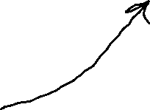



Slide 9



















Slide 10






















Slide 11



















Slide 12
